Slide 1
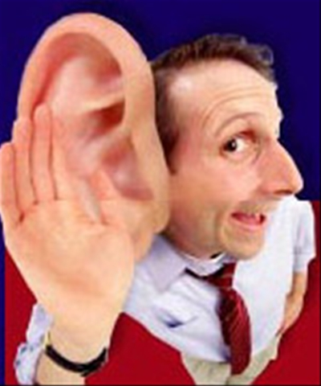
Things That Sound Biblical
But Are Not

Slide 2
# 1 - The Repenter’s Prayer
“Lord I Accept You As My Lord and Savior. I Know You Died On The Cross to Save Me From My Sins. I Repent of My Sins and Ask For Your Salvation. I Let You Into My Heart.”

Slide 3
Romans 10:12-13
“For there is no distinction between Jew and Greek; for the same Lord is Lord of all, abounding in riches for all who call upon Him; for ‘Whoever will call upon the name of the Lord will be saved.’”

Slide 4
Romans 10:12-13
“For there is no distinction between Jew and Greek; for the same Lord is Lord of all, abounding in riches for all who call upon Him; for ‘Whoever will call upon the name of the Lord will be saved.’”

Slide 5
Acts 22:16
“And now why do you delay? Arise, and be baptized, and wash away your sins, calling on His name.”

Slide 6
Acts 22:16
“And now why do you delay? Arise, and be baptized, and wash away your sins, calling on His name.”

Slide 7
#2 – Baptism Is An Outward Sign of An Inward Salvation.
There Is Nothing In The Bible That Remotely Teaches This.
There Is No Example That Shows This Understanding.
Why Are People So Against Baptism?
The Devil Always Wants Us To Believe The Opposite.

Slide 8
Is Salvation Left or Right?
Mark 16:16
Acts 2:38
Acts 2:41
1 Cor. 12:13
1 Pet. 3:21
Believe & Be Baptized
Repent & Be Baptized
Those Baptized
Were All Baptized
Baptism
Saved
For Forgiveness
Were Added
Into One Body
Does Now Save You

Slide 9
#2 – Baptism Is An Outward Sign of An Inward Salvation.
1 Corinthians 1:13-17

Slide 11
1 Sam. 16:7
“For God sees not as man sees, for man looks at the outward appearance, but the Lord looks at the heart.”

Slide 13
Things That Sound Biblical
But Are Not

Slide 14
# 1 - The Repenter’s Prayer #2 – Baptism Is An Outward Sign of An Inward Salvation.

Slide 15
#3 – What You Do Doesn’t Matter; It’s All About Grace.
Grace Is A Free Gift…You Can’t Earn It.
Grace Requires No Works.
Grace Is Made Void If Works Are Required.

Slide 16
Out Of Focus
Rom. 3:24, 27-28
Rom. 11:6
2 Tim. 1:9

Slide 17
In “Complete” Focus
Acts 11:21-23
Acts 13:42-44

Slide 18
Eph. 2:8
8 For by grace you have been saved through faith; and that not of yourselves, it is the gift of God;
9 not as a result of works, that no one should boast.
10 For we are His workmanship, created in Christ Jesus for good works, which God prepared beforehand, that we should walk in them.

Slide 19
In Addition
“Walk”
“Pray”
“Sing”
“Practice”
“Give”
“Wash”
“Speak”
“Live”

Slide 20
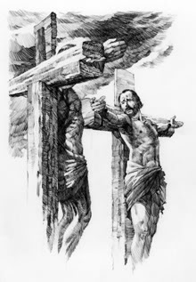
#4 – You Can Be Saved Just Like The Thief On The Cross
Without BAPTISM.
He Was Saved Without Baptism and We Can Also Be.

Slide 21
BEFORE or AFTER
How Much Do We Really Know About The Thief?
Jew or Gentile?
Did Jesus Say These Words Before The Great Commission or After?

